Slide 1
Price Whispers: Decrypting the Cryptocurrency Closing Code
Archita Ray
Sai Mona Duvvapu

Slide 2
Table of contents
01
Problem Statement
02
Exploratory Data Analysis
03
Modeling & Results
04
Future Scope
03
Preprocessing

Slide 3

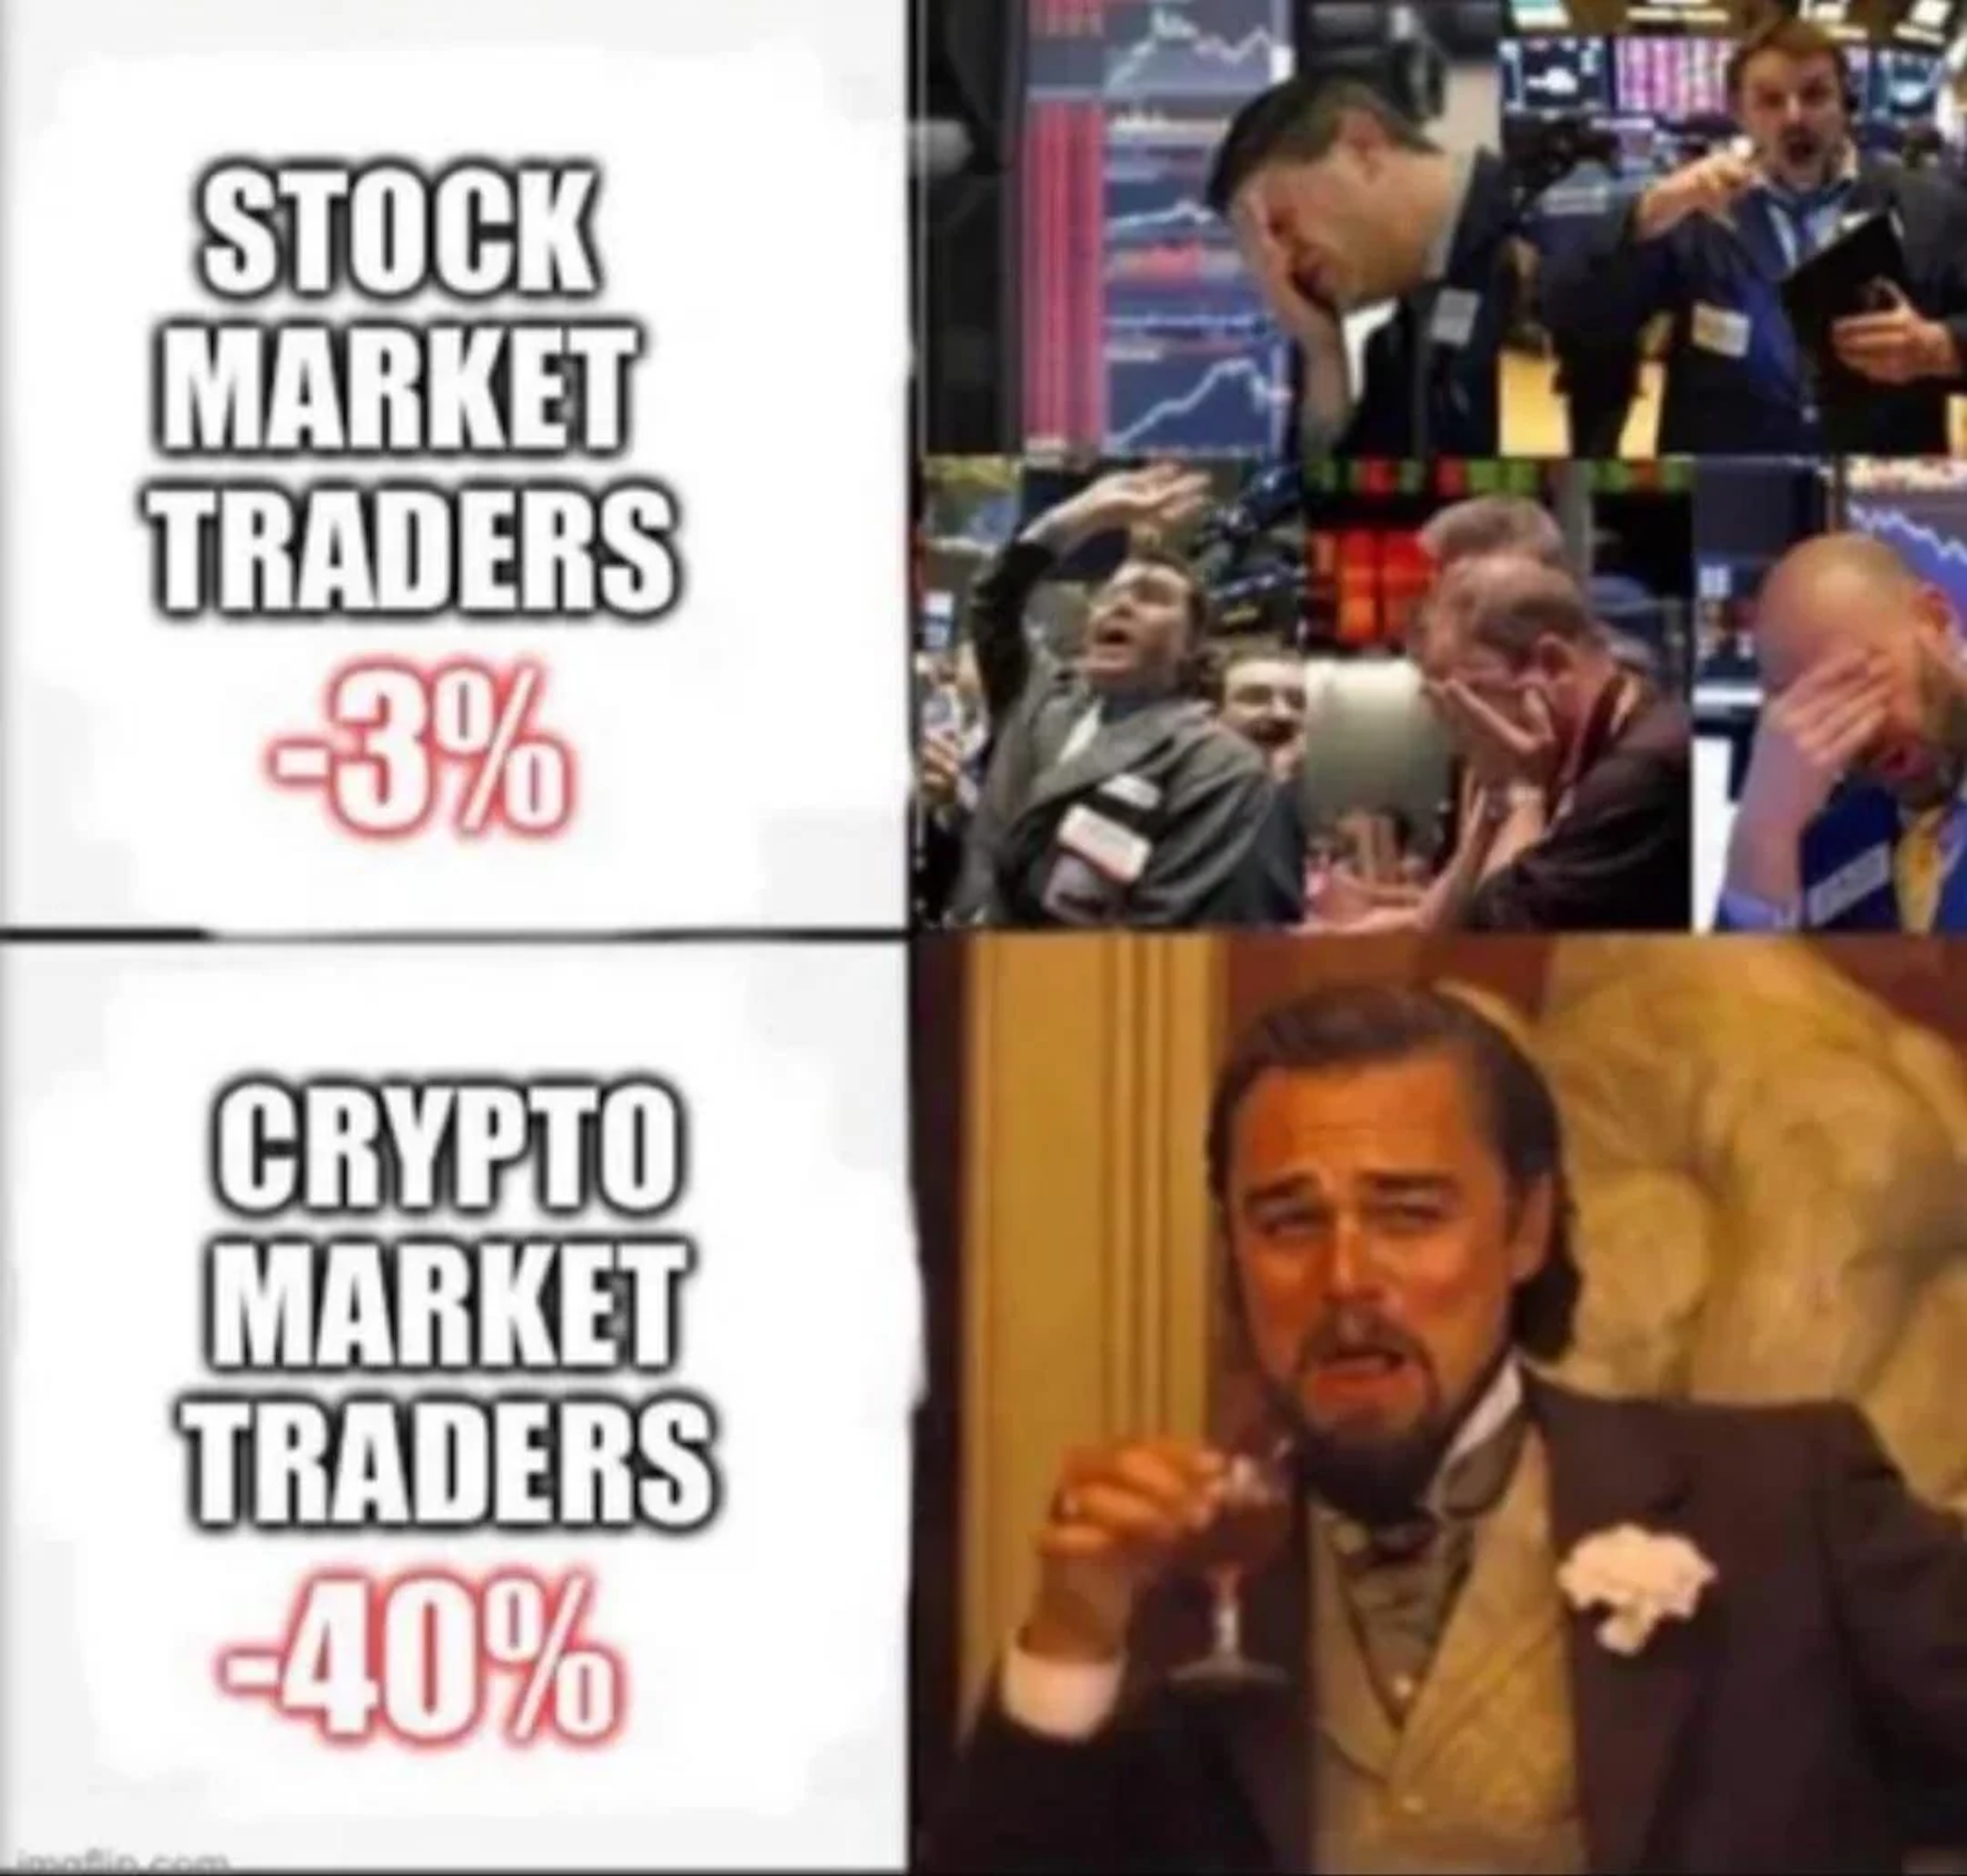

How do we feel about crypto?
“My crypto wallet is like an onion. When you open it, you want to cry.”

Slide 4


What is Cryptocurrency?

Slide 5
Bitcoin
Bitcoin is a form of digital currency that uses blockchain technology to support transactions between users on a decentralized network.
As of 19th Feb’24,
1 BTC
$ 52,000

Slide 6
Problem Statement
In the dynamic landscape of cryptocurrencies, the ability to anticipate price fluctuations is paramount for maximizing investment returns.
Primary Objective: To explore the predictive modeling of Bitcoin prices, aiming to provide investors with actionable insights into future price movements. By leveraging advanced analytical techniques, we seek to empower investors with the capability to anticipate changes in their portfolio value, thereby facilitating strategic decision-making to optimize returns.
Notes:
In the rapidly evolving world of cryptocurrencies, investors face significant challenges in predicting price movements due to the market's high volatility and non-stationary nature. However, by harnessing the power of machine learning algorithms trained on extensive historical market data, our platform seeks to provide users with actionable predictions to improve their investment strategies.

Slide 7
01
Exploratory Data Analysis

Slide 8
Data : Train Dataset
 | Column | Description
1 | Timestamp | Timestamp for the minute covered by the row.
2 | Asset_ID | An ID code for the cryptoasset
3 | Count | The number of trades that took place this minute
4 | Open | The USD price at the beginning of the minute
5 | High | The highest USD price during the minute
6 | Low | The lowest USD price during the minute
7 | Target | 15 minute residualized returns
8 | Volume | The number of cryptoasset units traded during the minute
9 | VWAP | The volume weighted average price for the minute.
10 | Close | The USD price at the end of the minute
Notes:
(24236806, 10)

Slide 9
Data : Asset Details
Notes:
(24236806, 10)

Slide 10
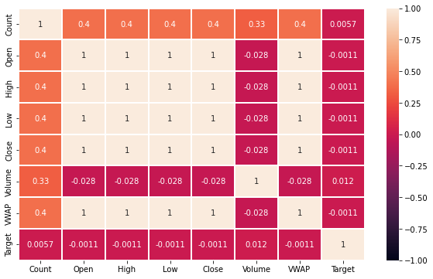
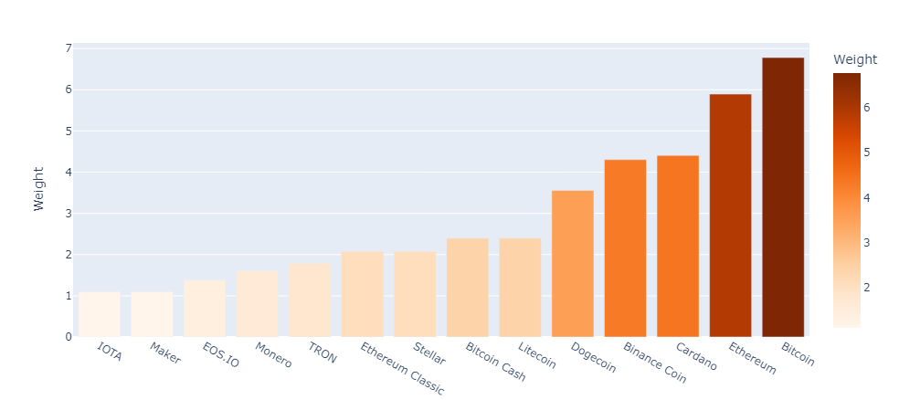
EDA (1/2)
Correlation Matrix
Assets

Slide 11
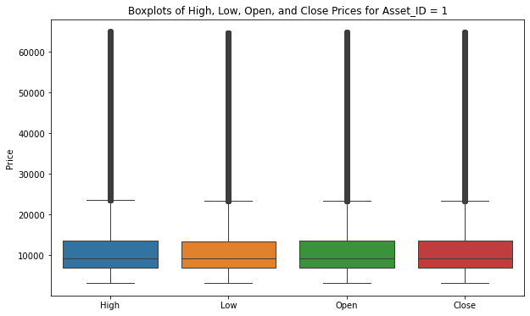
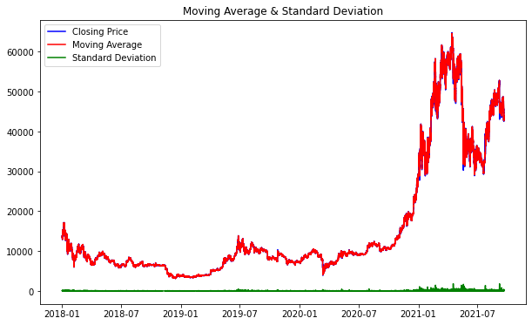
EDA (2/2)
Variability of Values
Statistics over the timeframe

Slide 12
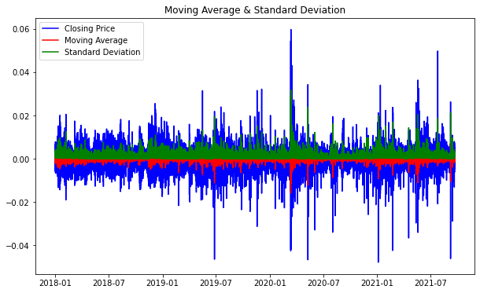
Stationary or Not? And how?
Moving Average is not stable
After applying log on the difference in consecutive “Close” values

Slide 13
02
Preprocessing

Slide 14
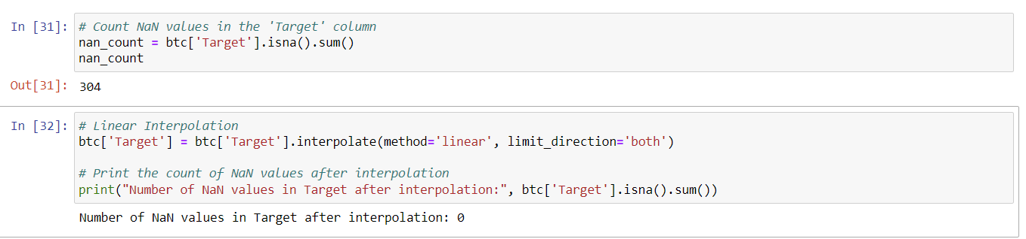
Missing Values (1/2)
Addressing the NaN target values (Interpolation)

Slide 15
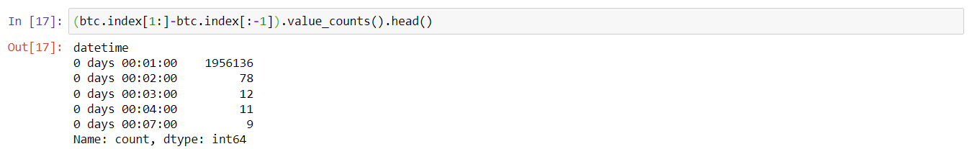
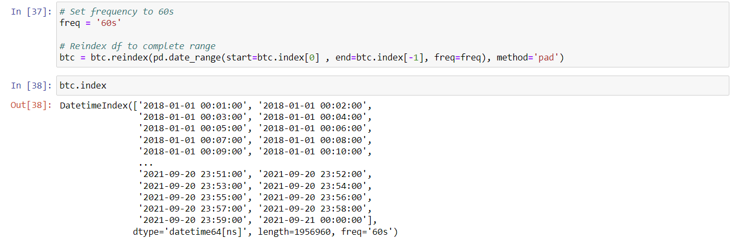
Missing Values (2/2)
Addressing the missing rows (Padding)

Slide 16
03
Modeling & Results

Slide 17
Feature Engineering
Feature | Description
Date | Date component extracted from the timestamp indicating the date of the observation.
Hour | Hour component extracted from the timestamp indicating the hour of the observation.
Minute | Minute component extracted from the timestamp indicating the minute of the observation.
DayOfWeek | Day of the week extracted from the timestamp indicating the day of the week (0-6: Mon-Sun)
PriceChange | Percentage change in the Close price compared to the previous timestamp.
SMA_30min | Simple Moving Average of the Close price over a 30-minute window.
EMA_30min | Exponential Moving Average of the Close price over a 30-minute window.
Close_Lagged_1 | Lagged version of the Close price, representing the Close price at the previous timestamp.

Slide 18
Data Model Overview
LSTM (Long Short-Term Memory): recognizes patterns in data sequences- stock prices and forecasts future stock values.
The last closing price of every hour
Volume, Target, Weight, Price Change, SMA_30min
Predicted
Closing price
FILTERED
DATA
INPUT
OUTPUT

Slide 19
Model Details
Layer | Number of Units | Dropout Rate | Return Sequence
LSTM1 | 512 | 0.3 | True
LSTM2 | 256 | 0.3 | True
LSTM3 | 128 | 0.3 | False
Layer | Number of Units | Activation Function
Dense1 | 64 | ReLU
Output Dense | 1 | -
Training Epochs: 250
Validation Split: 0.2
Learning Rate (Optimizer): 0.0001 with Adam optimizer
Loss Function: Mean Squared Error (mse)
Batch Size: 32
Early Stopping: Patience of 5 epochs

Slide 20
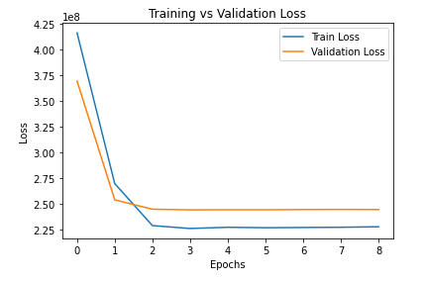
Model Outcome
RMSE | 18.02
MAE | 13.52
Models’ stable validation loss curve over epochs indicates that it generalizes well to new data

Slide 21
03
And then, some more modeling!

Slide 22
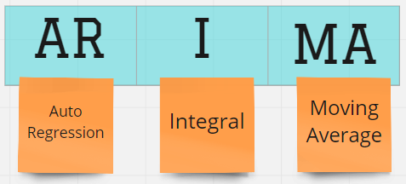
ARIMA
Autoregressive Integrated Moving Average
Statistical analysis model that uses time-series data to better understand the data set or predict future trends.

Slide 23
ARIMA
AR(p) stands for the autoregressive model; the p parameter is an integer that confirms how many lagged series are going to be used to forecast periods ahead.
I(d) is the differencing part; the d parameter tells how many differencing orders are going to be used to make the series stationary.
MA(q) stands for moving average model, the q is the number of lagged forecast error terms in the prediction equation. SARIMA is a seasonal ARIMA and it is used with time series with seasonality.
P – No of previous values used to predict the current value
D – No. of times we difference the data to make it stationary
Q – Error term from previous data point
**Used the best combination of P, Q keeping d=1 as constant

Slide 24
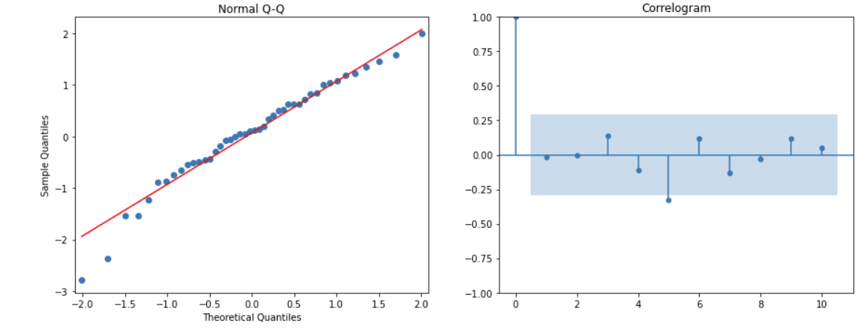
Model Outcome
Arima Residuals QQ Plot
Autocorrelation Plot
Normal Probability Plot

Slide 25
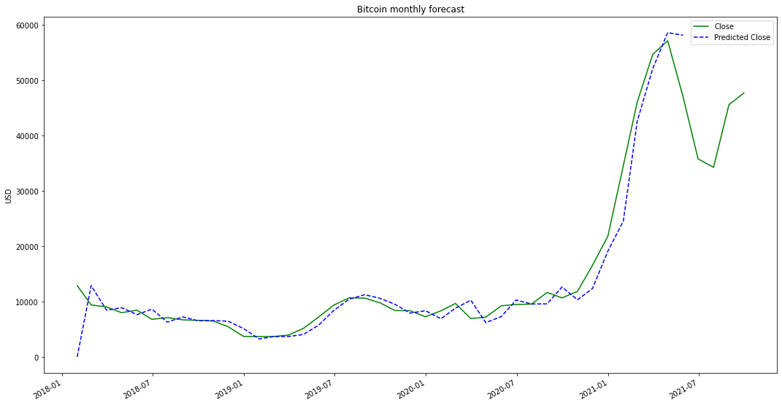
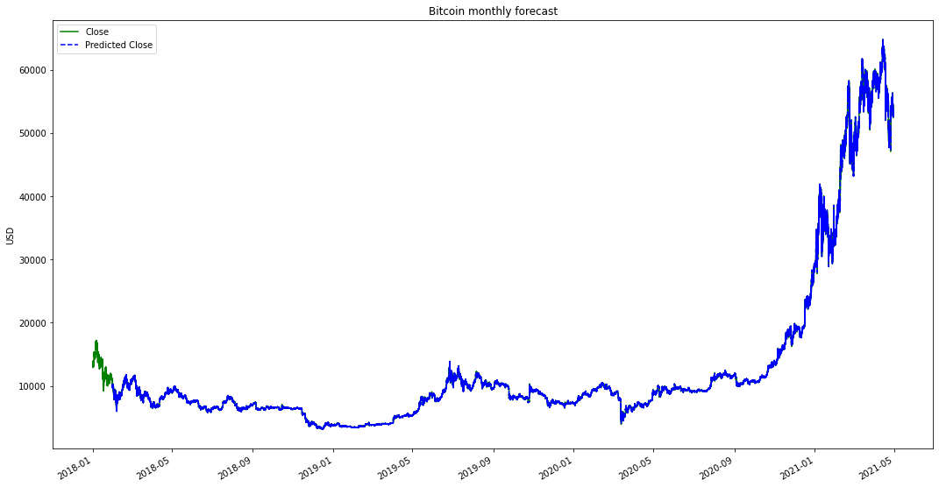
Model Outcome (Forecasts)
Best RMSE | 22.6797

Slide 26
04
Cryptic Crypto Future

Slide 27

What's in Store for Cryptocurrency?
Increased mainstream adoption and everyday use - As more businesses and services accept crypto payments and crypto investing becomes more accessible, everyday usage and adoption could grow significantly.
Store of value and inflation hedge - If adoption continues growing, bitcoin and other cryptos could solidify roles as digital stores of value, similar to gold. Their fixed or limited supplies could make them attractive inflation hedges.
Increased institutional investment - Growing interest from institutional investors like hedge funds and banks could further drive crypto adoption and valuations. The crypto market cap remains relatively small compared to other assets.

Slide 28
Thanks!
Do you have any questions?

